Slide 1


Are you registered with a GP practice in Leicestershire?
Find out about changes to same-day appointments from 1 April 2026
www.bit.ly/sda-leics

Slide 2
Need help fast
and it isn’t life threatening?
New same-day appointments from 1 April 2026
From 1 April 2026, if you need to be seen on the same day, NHS 111 or your GP practice may offer you a new type of appointment during evenings, weekends and bank holidays.
There is nothing you need to do differently. An appointment may be offered, if it is right for you, when you contact NHS 111 or your GP practice as normal with an urgent need.
www.bit.ly/sda-leics

Slide 3

Need help fast
and it isn’t life threatening?
New same-day appointments from 1 April 2026
Appointments are available at six locations on weekdays and eight locations at weekends.
There are consistent opening times across Leicestershire:
Monday to Friday: 6.30pm to 8.30pm
Saturdays: 9am to 5pm
Sundays and bank holidays: 10am to 2pm.
Appointments are with a GP and five minutes longer than standard GP appointments.
It is an appointment-only service. Appointments are available via NHS 111. A small number of appointments are available through GP practices.
www.bit.ly/sda-leics

Slide 4
Need help fast
and it isn’t life threatening?
Appointment locations
Location
Charnwood Surgery (Mountsorrel) | 7 days a week
The Centre Surgery (Hinckley) | 7 days a week
Castle Medical Group (Ashby) & Long Lane Surgery (Coalville) – alternating weeks | 7 days a week
Melton Hospital (Melton Mowbray) | 7 days a week
Feilding Palmer Hospital (Lutterworth) | Weekends only
St Luke’s Treatment Centre (Market Harborough) | 7 days a week
Warren Lane Surgery (Leicester Forest East) | 7 days a week
Oadby Urgent Treatment Centre (Oadby) These are appointment‑only slots delivered at the same premises as the Urgent Treatment Centre, in addition to normal UTC services | 7 days a week
www.bit.ly/sda-leics

Slide 5

Need help fast
and it isn’t life threatening?
How to get an appointment
If you need help quickly, and self-care hasn’t worked or it’s more serious, contact your GP practice, or NHS 111 when your practice is closed.
If you need to be seen on the same day, they will help arrange the right appointment for you, which could be one of the new appointments.
www.bit.ly/sda-leics

Slide 6

Need help fast
and it isn’t life threatening?
If you need to be seen on the same day
Your practice or NHS 111 will recommend the right appointment:
At your practice
A pharmacy (under the Pharmacy First scheme)
An urgent treatment centre
A new same-day appointment, during evenings weekends and bank holidays.
www.bit.ly/sda-leics

Slide 7
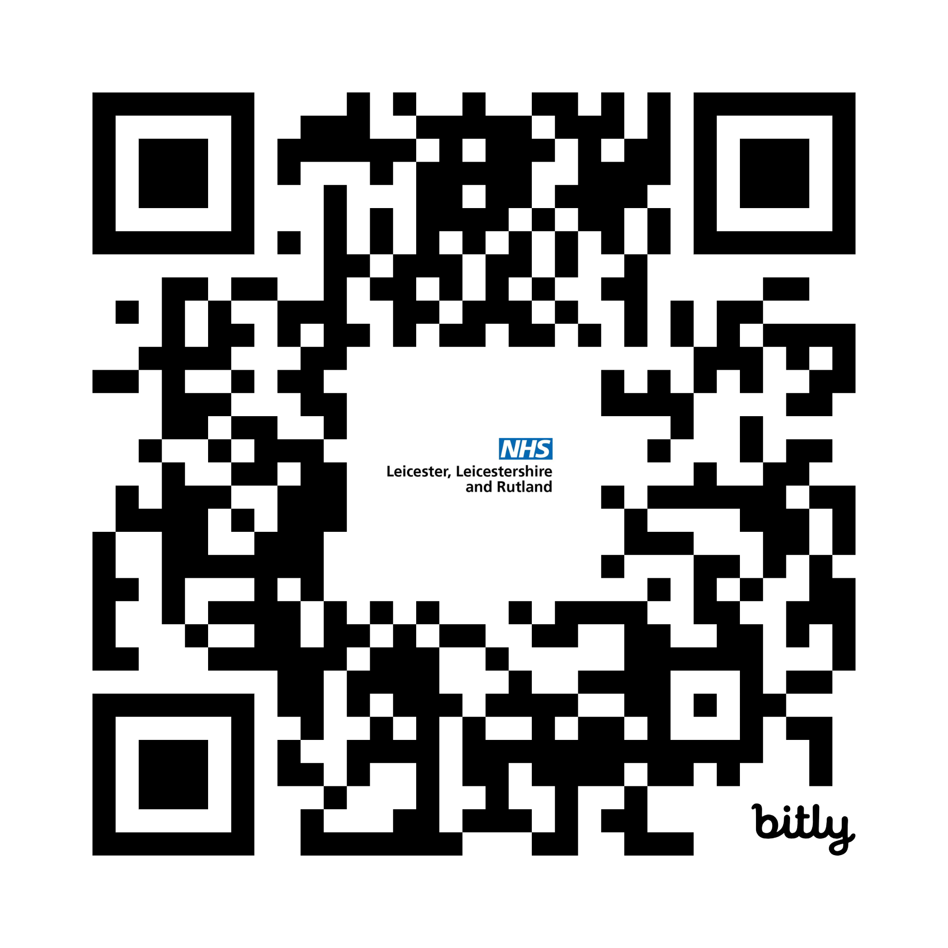




Need help fast
and it isn’t life threatening?
Share your views on the appointments,
to help us improve future services
Fill in our questionnaire by Sunday 14 June 2026
Complete the questionnaire online:
www.leicesterleicestershireandrutland.icb.nhs.uk/be-involved/sda-leicestershire/
Email your views to: llricb-llr.beinvolved@nhs.net
Call 0116 295 7532 to receive a paper copy of the questionnaire or information in another format
Write to us at Freepost Plus RUEE-ZAUY-BXEG, Same Day Questionnaire, NHS LLR ICB, Room G30, Pen Lloyd Building, County Hall, Glenfield, Leicester, LE3 8TB
www.bit.ly/sda-leics

Slide 8
Need help fast
and it isn’t life threatening?
To find out more
www.bit.ly/sda-leics

