Slide 1


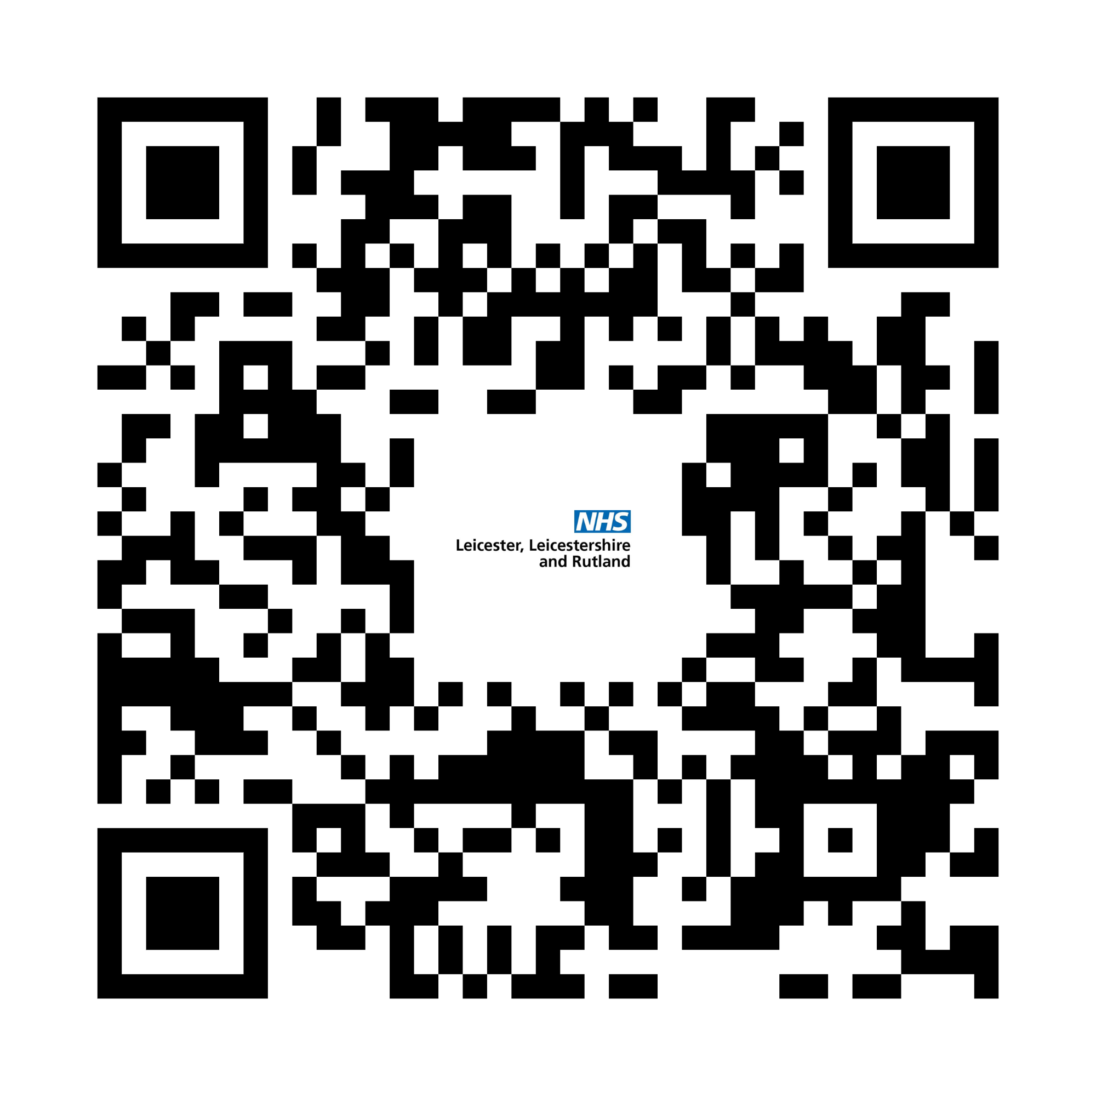

Need help fast in Rutland
and it isn’t life threatening?
Get the right NHS care
in two simple steps
https://leicesterleicestershireandrutland.icb.nhs.uk/need-help-fast-rutland/

Slide 2




If your problem is minor and you haven’t been able to treat it yourself at home, try:
Step 1:
Try Self Care First
The NHS App or nhs.uk
NHS 111 online
Your local pharmacy
These services are quick, easy and often all you need.
https://leicesterleicestershireandrutland.icb.nhs.uk/need-help-fast-rutland/

Slide 3





Need help fast
and it isn’t life threatening?
If it’s more serious or Step 1 didn’t work:
Step 2:
Need more help?
Contact your GP practice
Or call NHS 111
They’ll help book the right appointment for you.
https://leicesterleicestershireandrutland.icb.nhs.uk/need-help-fast-rutland/

Slide 4

Need help fast
and it isn’t life threatening?
If you need to be seen on the same day
Your practice or NHS 111 will recommend the right appointment:
At the practice
A pharmacy (under the Pharmacy First scheme)
Rutland Minor Illness and Minor Injury Service
A GP practice or health centre in Leicestershire (during evenings, weekends and bank holidays).
https://leicesterleicestershireandrutland.icb.nhs.uk/need-help-fast-rutland/

Slide 5
Open 1pm-9pm, seven days a week
Booked appointments via your GP practice or NHS 111
The new Rutland Minor Illness and Injury Service is open from 1 April 2026
Initially a few walk-in slots for minor injuries only
Extended x-ray availability on Mondays, Wednesdays and Thursdays (11am–7pm) - from 13 April 2026
Rutland Memorial Hospital, Cold Overton Road, Oakham, LE15 6NT
This service has replaced the Minor Injury Unit and Urgent Care Centre.
https://leicesterleicestershireandrutland.icb.nhs.uk/need-help-fast-rutland/

Slide 6

Need help fast
and it isn’t life threatening?
If it’s a life or limb-threatening emergency, go straight to the closest emergency department or call 999.
In a mental health crisis, call NHS 111 and the select the mental health option.
This service is open 24 hours a day, seven days a week.
https://leicesterleicestershireandrutland.icb.nhs.uk/need-help-fast-rutland/

Slide 7
Need help fast
and it isn’t life threatening?
What is right care, right place?
So that NHS resources are being used in the best way for everyone, the NHS aims to match each patient to:
the right level of care,
with the right health professional,
in the right part of the NHS,
first time.
https://leicesterleicestershireandrutland.icb.nhs.uk/need-help-fast-rutland/

Slide 8
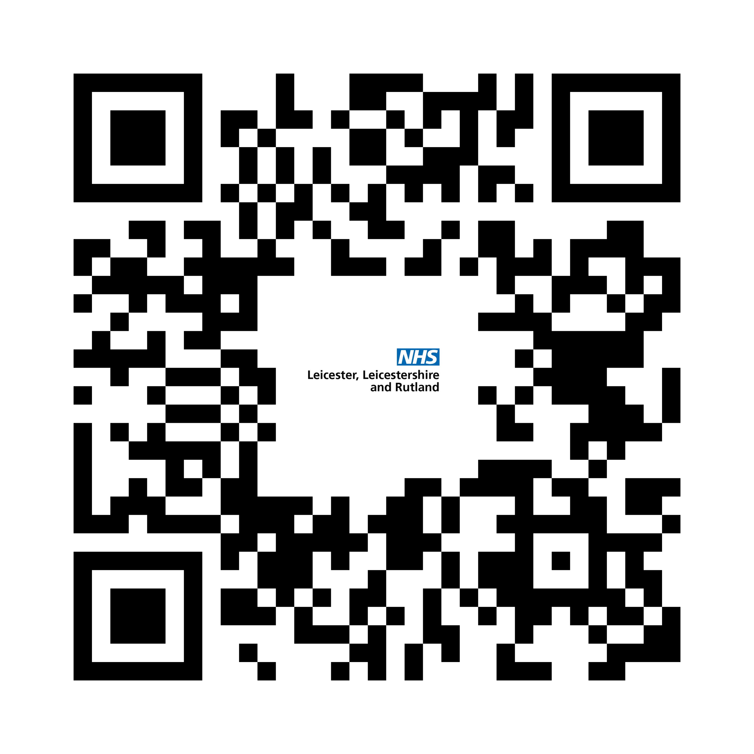
Need help fast
and it isn’t life threatening?
Want to know more?
https://leicesterleicestershireandrutland.icb.nhs.uk/need-help-fast-rutland/

